Slide 1
Example Powerpoint
Slides for your Theme

Slide 2
Theme Phrase
New Real
NEW REALity

Slide 3
Headline Challenge List
Headline Ideas
Potential story angles
Brave New World (English class)
Nothing New
Virtual Reality
Reality Check
Whole New Ballgame
Brand New (freshmen)
Different than Before
Cover all the transfer students and exchange students (New Kids on the Block)
Atheletes training for a new season of their sport (The struggle is real)
Cover two different household dynamics – ex: same sex parents and raised by grandparents or adopted (Reality Check)

Slide 4
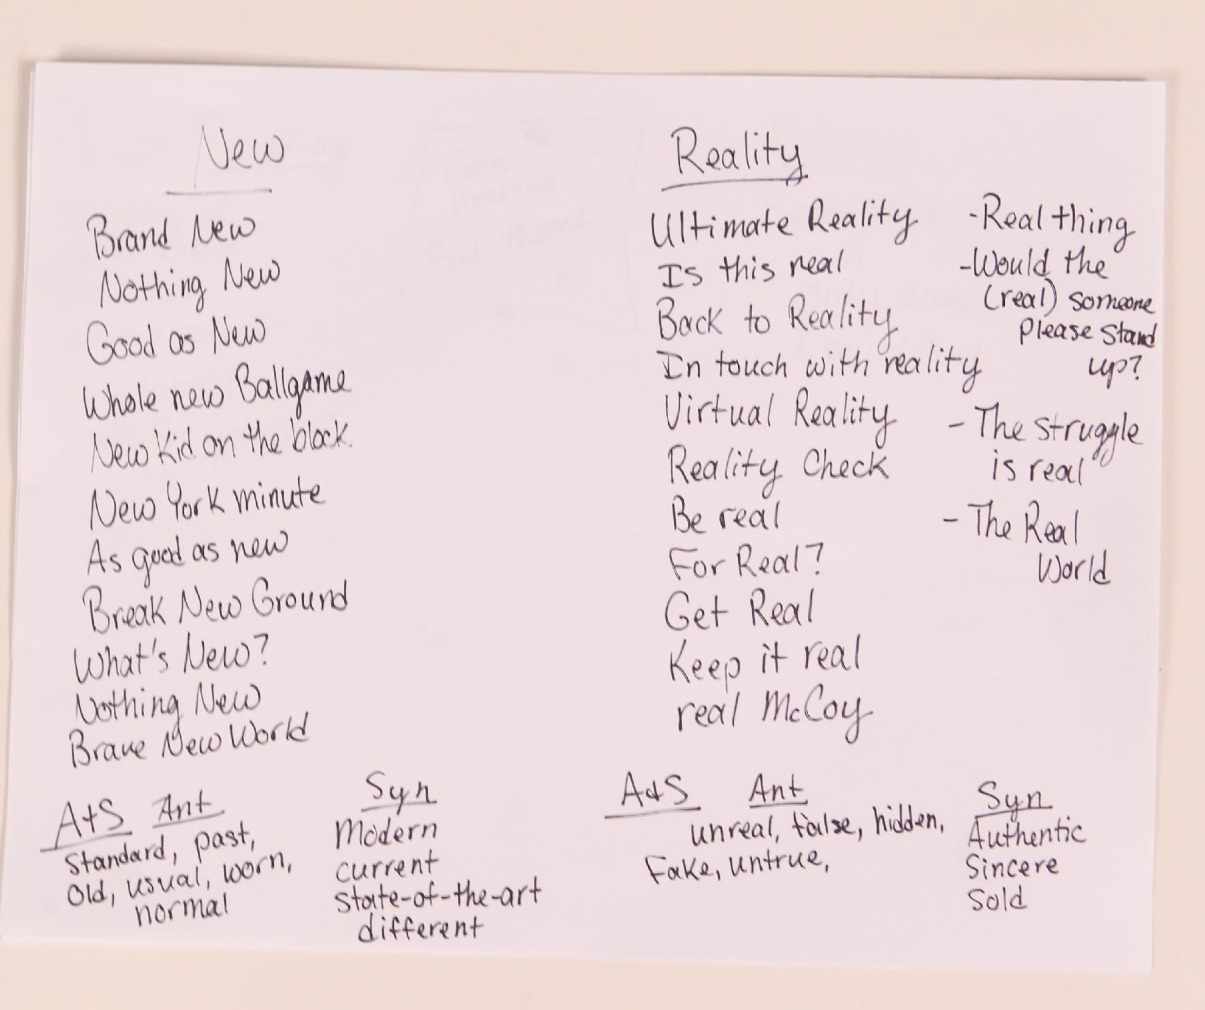
Headline Challenge

Slide 5
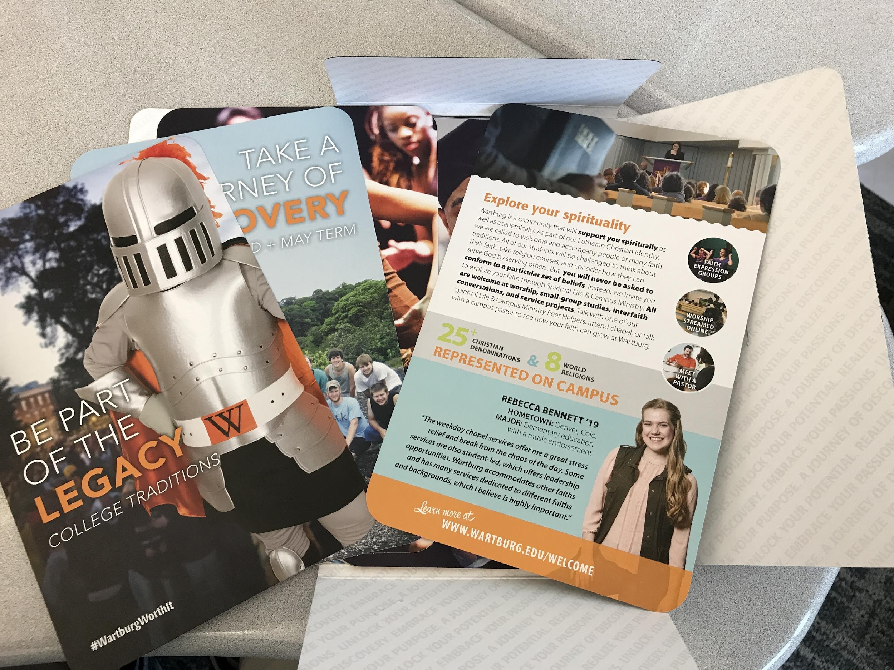
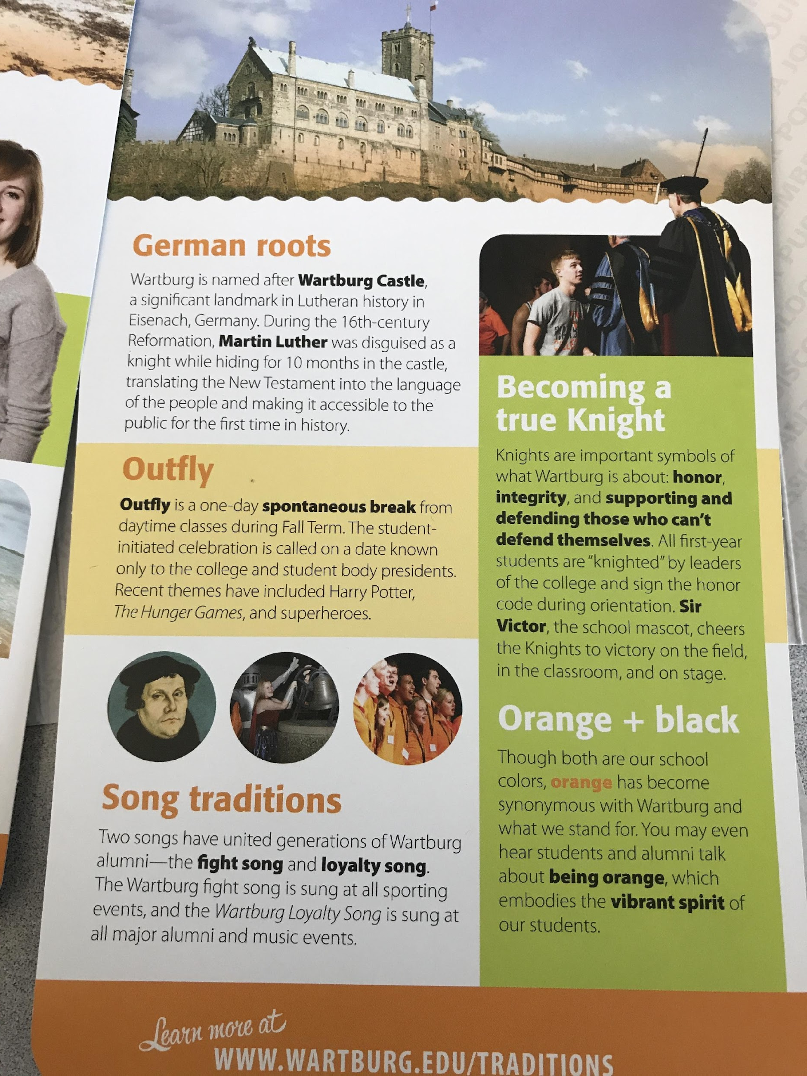
Inspiration sources

Slide 6
And their theme was born

Slide 8
COLORS

Slide 9
Inspiration

Slide 10
Color palettes

Slide 11
Headline head start
Get a start on designing some headlines
If handwritten is all you have time for that’s okay

Slide 12
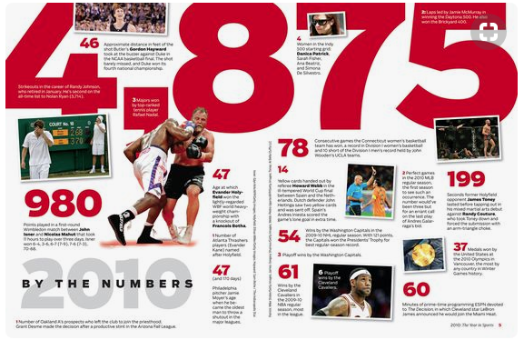
Spread Inspiration

Slide 13
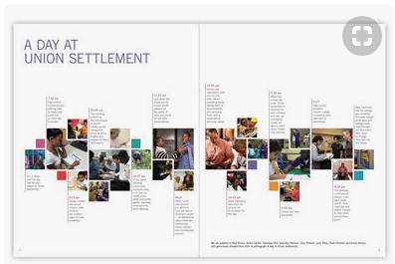
Inspiration

Slide 14
Spread Inspiration

Slide 15
Spread Inspiration

Slide 16
Spread Inspiration

Slide 17
Choose Coverage Type
Three main types
Traditional
Chronological
Blended

Slide 18
Theme Copy
Get a head start on theme copy
Create an outline for your theme copy
Theme copy will be one of the last things you finish
Developed all year
Cover all sections

